Slide 1
Science Communication
12/3/2025

Slide 2
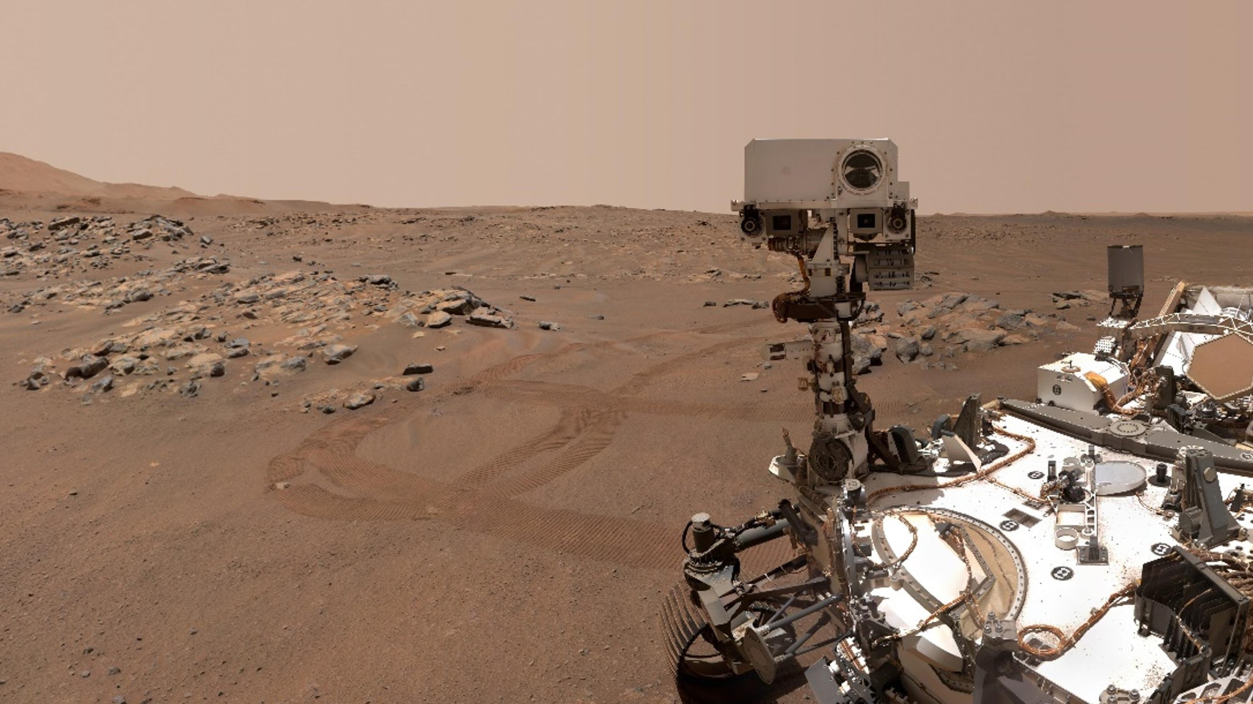
Science Communication
Gabrielle Suissa
PhD Student
Astronomy
Astrobiology
University of Washington
Astronomy Pre-MAP
12/03/2025
Credit: NASA/JPL-Caltech
Notes:
All views and opinions are my own.

Slide 3
How did you feel, as the audience?
What are some differences between my two introductions?

Slide 4

Rule #1: Consider Your Audience!!
You must tailor your talk to your audience
  General public? Peers? Experts?
Speak to your audience at their level.
Notes:
Consider your audience! What do they know? What do they care about? What do YOU want them to leave this talk knowing?

Slide 5
Connect with your audience
Your audience will be other astronomers, they will not be experts in your specific work!
Tie your work to bigger questions and concepts in astronomy
“Why should an average astronomer care about this work?”
Avoid jargon

Slide 6
Jargon comes in different flavors:
Technical Terms:
Acronyms:
Audience might know general STEM and Astro jargon (e.g., “magnitude”).
But, they won’t necessarily know your specific techniques, methods, etc.
Solution: Identify, then define & explain
Example:
“Magnesium perchlorate” ->
“Perchlorates are a type of salt found on Mars’ surface, and may melt ice into liquid water!”
Use acronyms sparingly
Audience will only remember 1-2 max
Define ALL acronyms
Example:
“The use of OSNB mode during the INMS observations of E21 on 28 October 2015 enabled the detection of H₂ in the plume”
INMS = Ion & Neutral Mass Spectrometer, an instrument that “sniffs” vapors and measures what molecules are present.

Slide 7
Jargon
What are some examples from your work?
Why do we use jargon?
  Is jargon always bad?
Notes:
Why do we use jargon when speaking to our colleagues?
Efficient means of communication
Certain jargon terms have very specific definitions, which makes these terms easier to use than repeating the definition
By using the language of your peers, you prove you are “in”
Out of habit
Why do we use jargon when speaking to the public?
Intimidation
To prove that we are smart
Is it necessarily bad to use jargon? (NO.)
It IS useful when speaking to your peers
When carefully defined and used, jargon can be utilized to make a public talk more efficient
Teaching the public a term can help the audience feel like they learned something and joined the “in” crowd

Slide 8
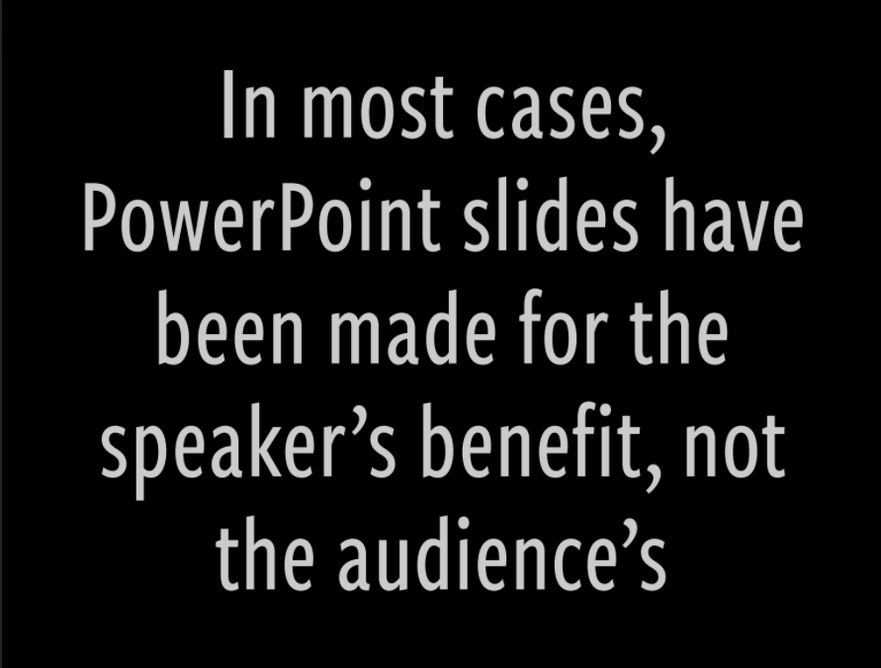

Slide 9
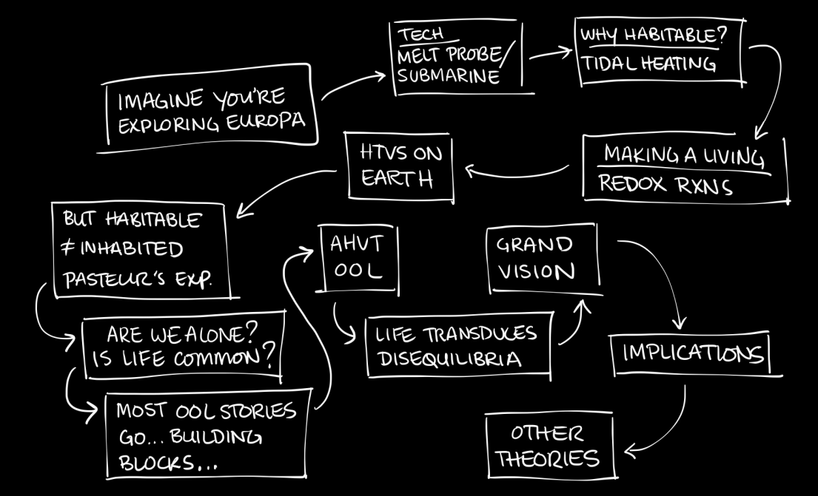
Before you start: OUTLINE

Slide 10
However large you think your text should be… make it larger.

Slide 11
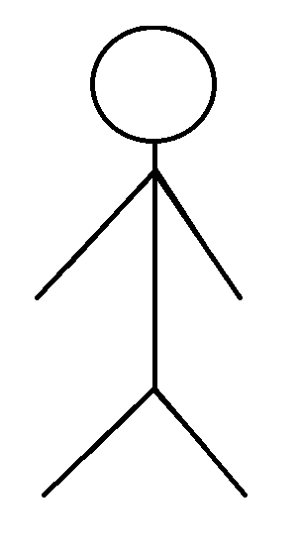

However large you think your text should be… make it larger.
For example:
>40 pt font for titles
>28 pt for text
“Is my text large enough?”
Step back ~10 feet from your screen.
If you can’t read the text, it’s too small.

Slide 12
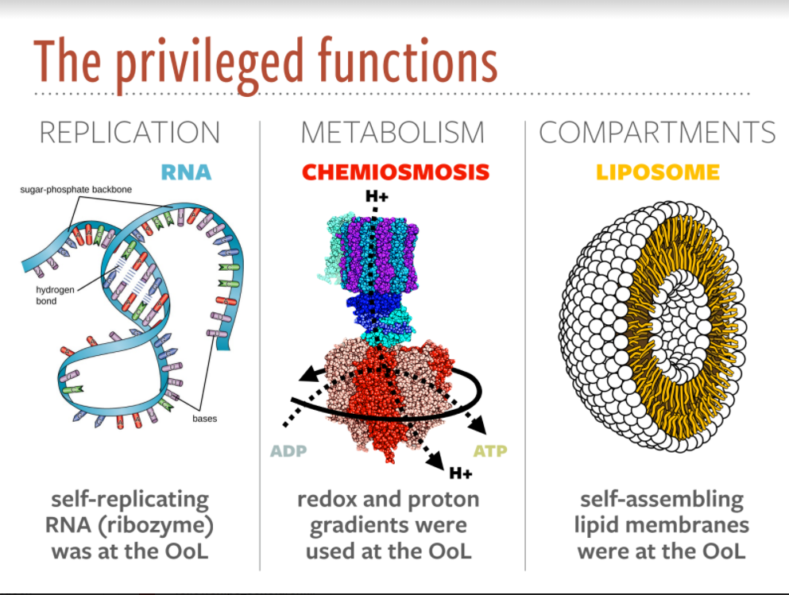

Slide 13
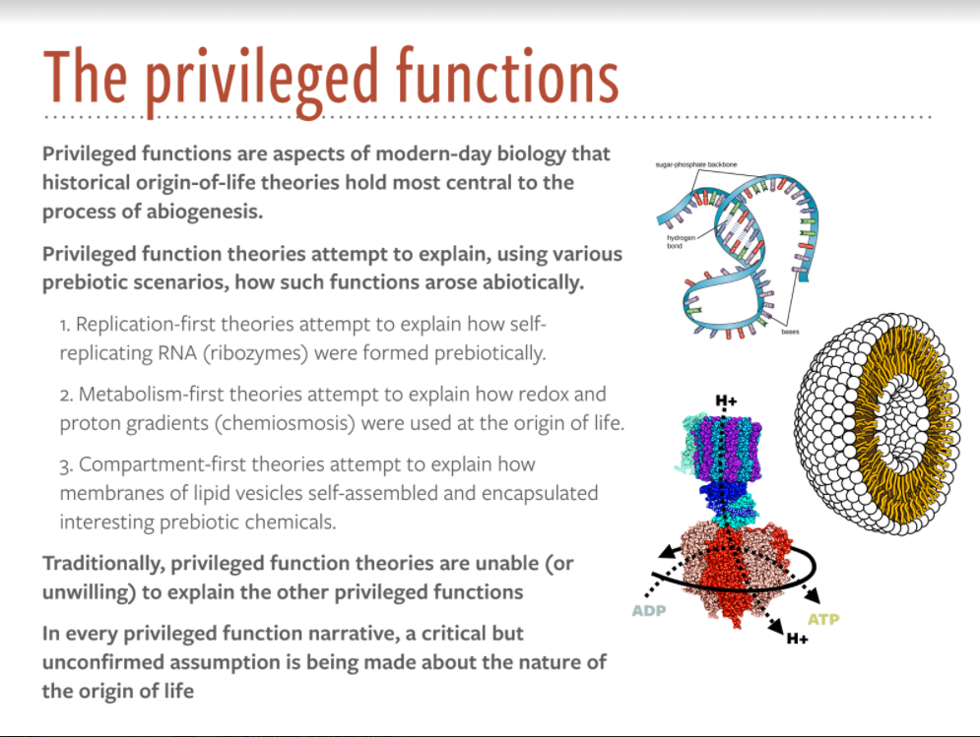
Notes:
Good: Color. Figures. Hierarchy of information
Bad: Too much text!!

Slide 14
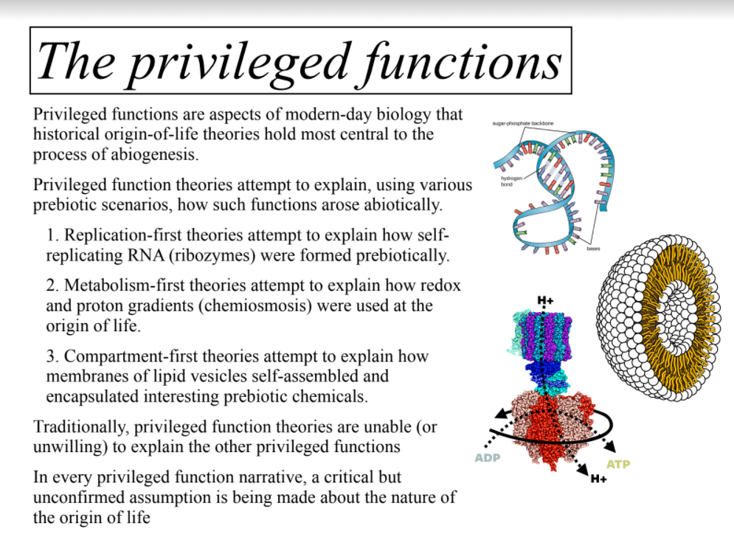
Notes:
Bad: too much plain text. All blends together.

Slide 15
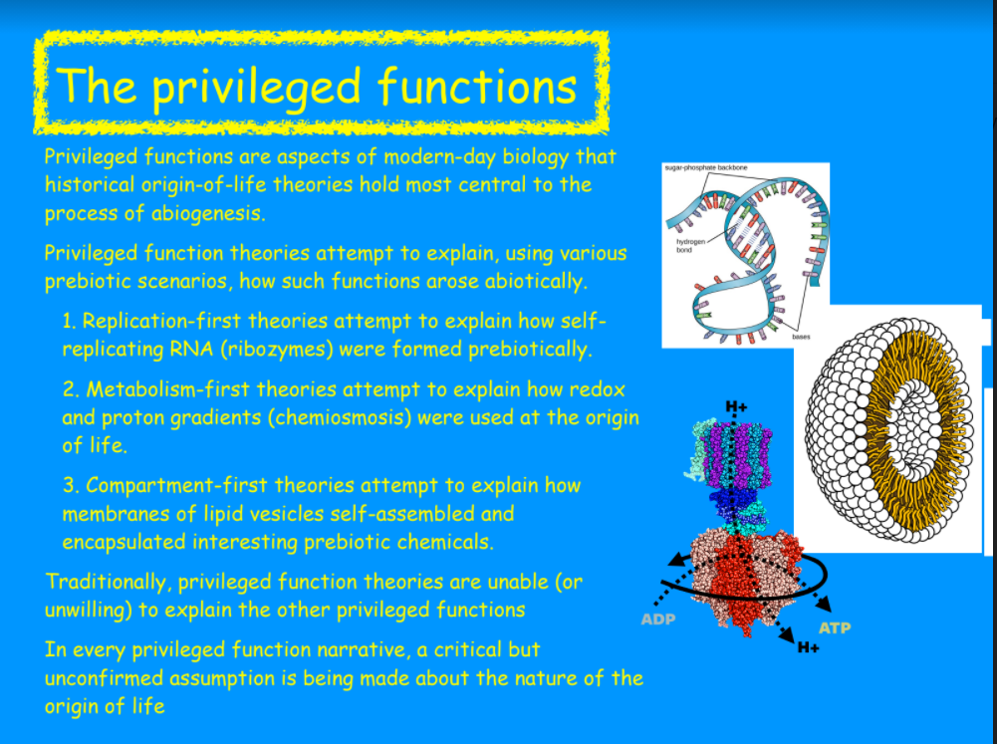
Notes:
Bad: Everything

Slide 16
Try and have a visually consistent slide deck
Stick with one theme, font, etc.
Don’t use clashing colors

Slide 17
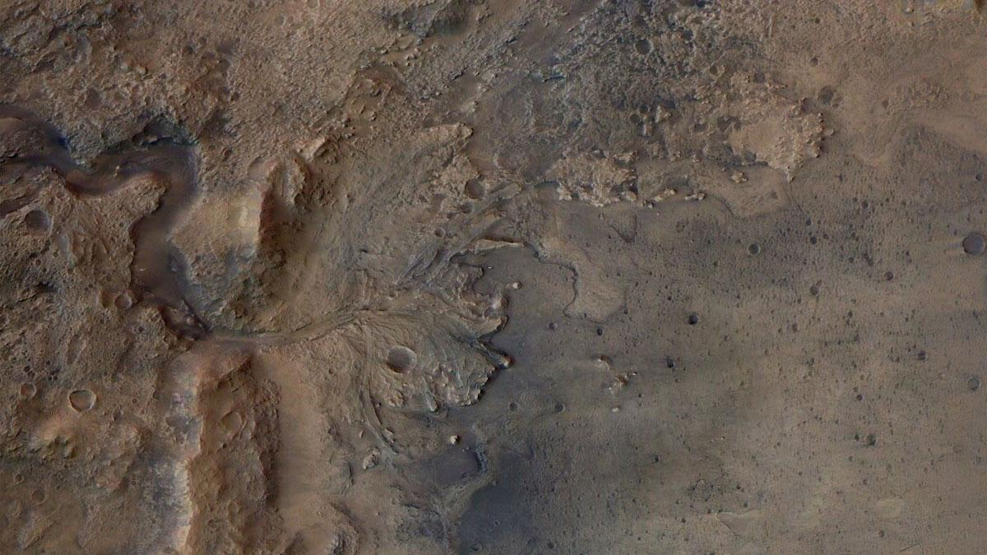
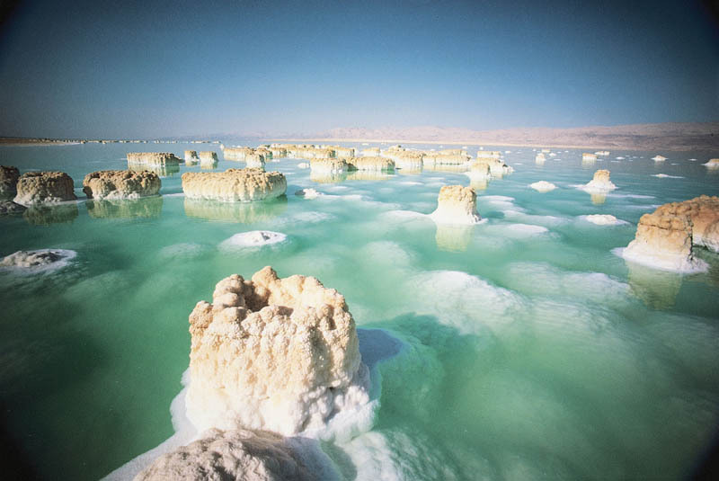

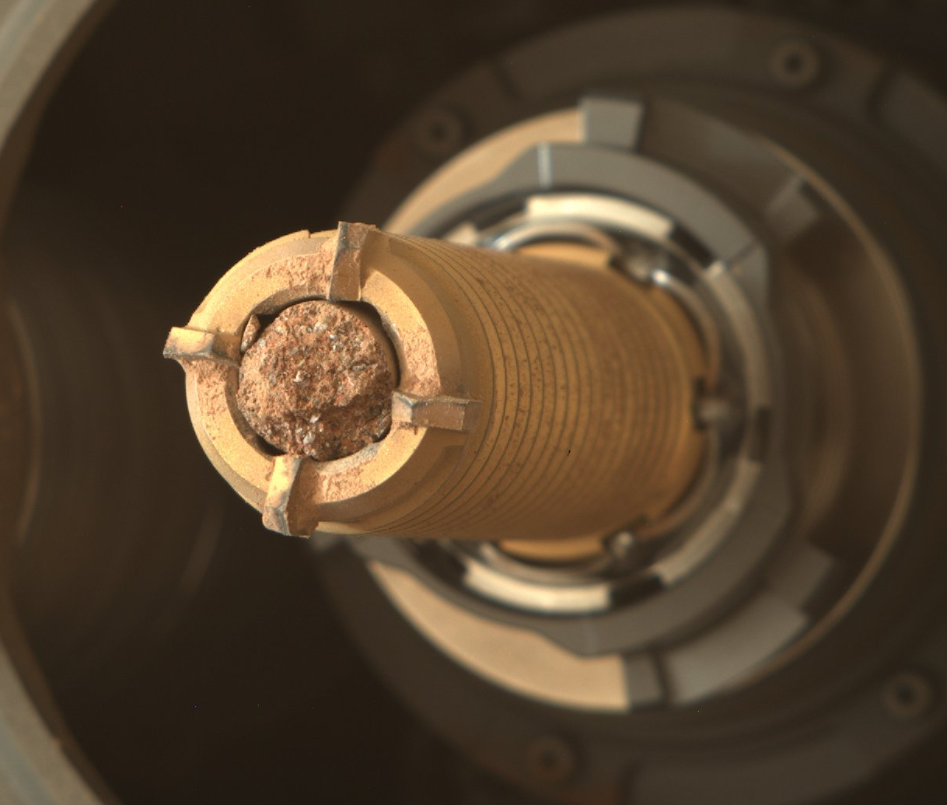
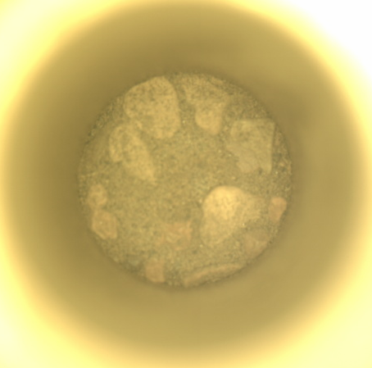
What was the lake like, long ago?
Seek signs of ancient life
Collect samples to return to Earth.
Notes:
The main goals for the mission are:

Slide 18
What was the lake like, long ago?
Seek signs of ancient life
Collect samples to return to Earth.
Notes:
The main goals for the mission are:

Slide 19
What was the lake like, long ago?
Seek signs of ancient life
Collect samples to return to Earth.
Notes:
The main goals for the mission are:

Slide 20
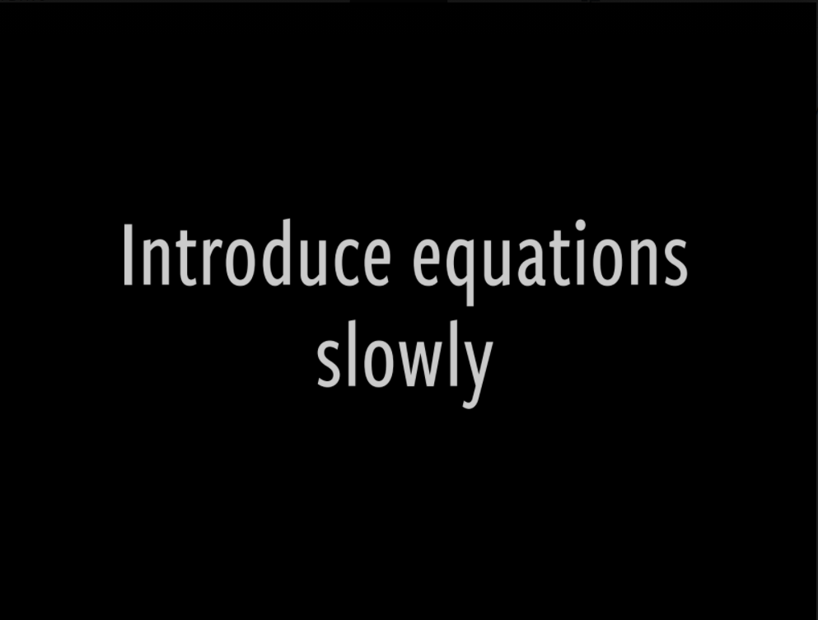
Notes:
Generally, I’d advise against using equations in talks, under most circumstances. The audience doesn’t need to know every equation you used to get your results
But, if you must use an equation because its essential to understanding your work.

Slide 21
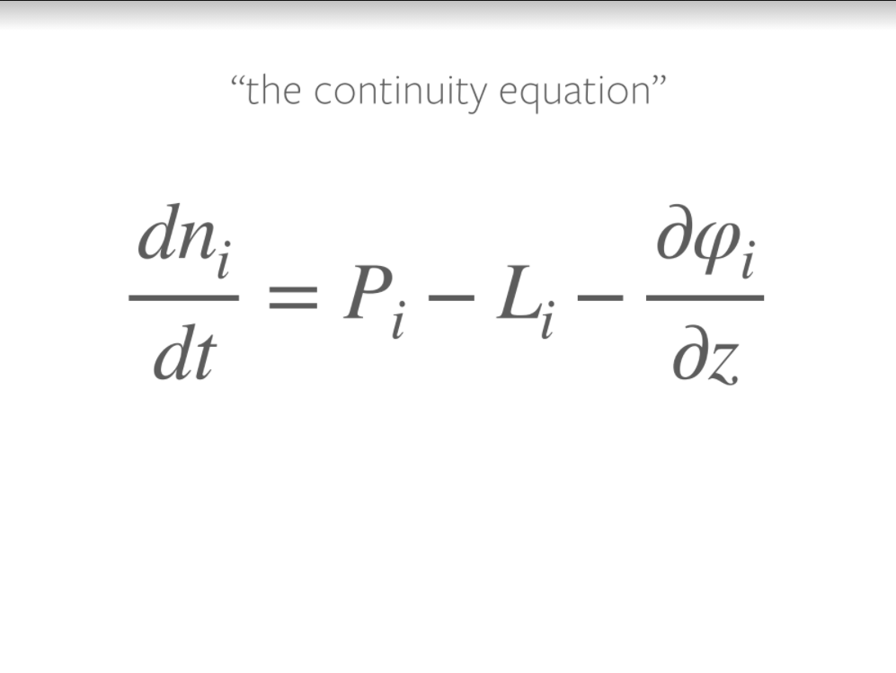
Notes:
Your audience likely does not have the context and background to understand every equation you use.
If you just put an equation up here, the audience

Slide 22
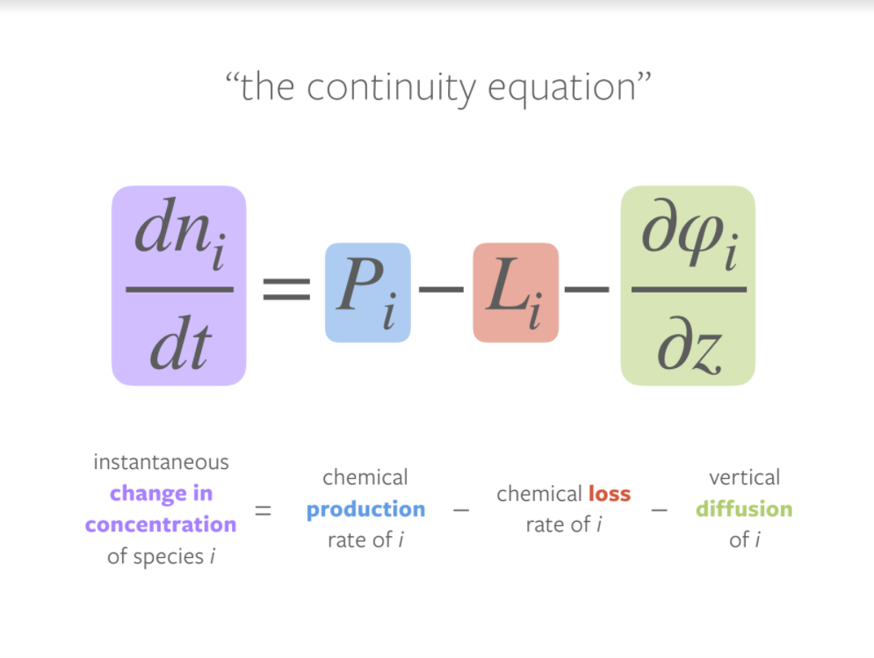
Notes:
Hold the audiences hand and walk them through your equations step by step

Slide 23
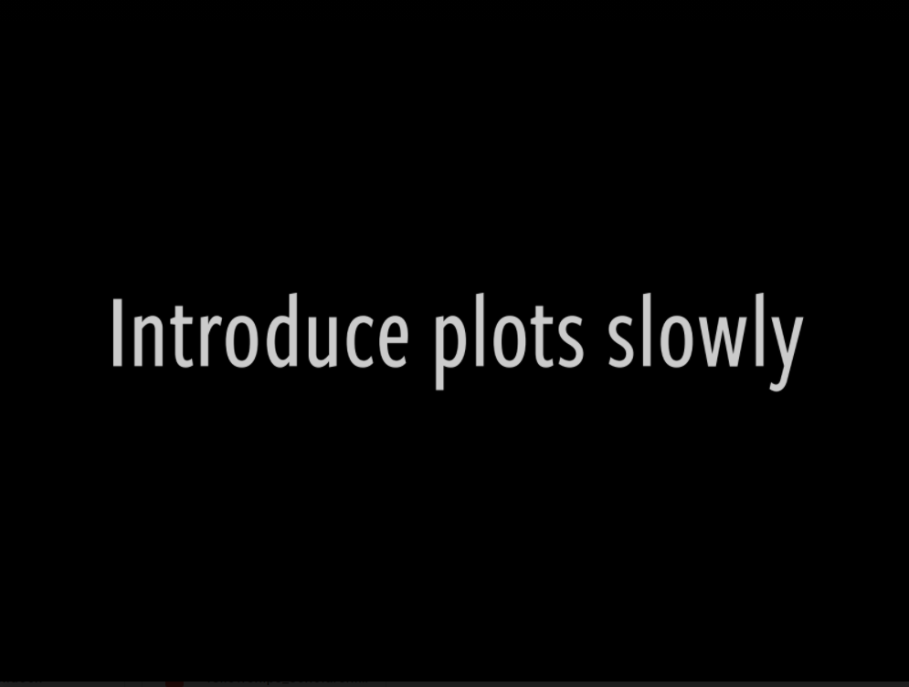
(Warning: Jumpscare)
Notes:
I don’t want anyone to be alarmed

Slide 24
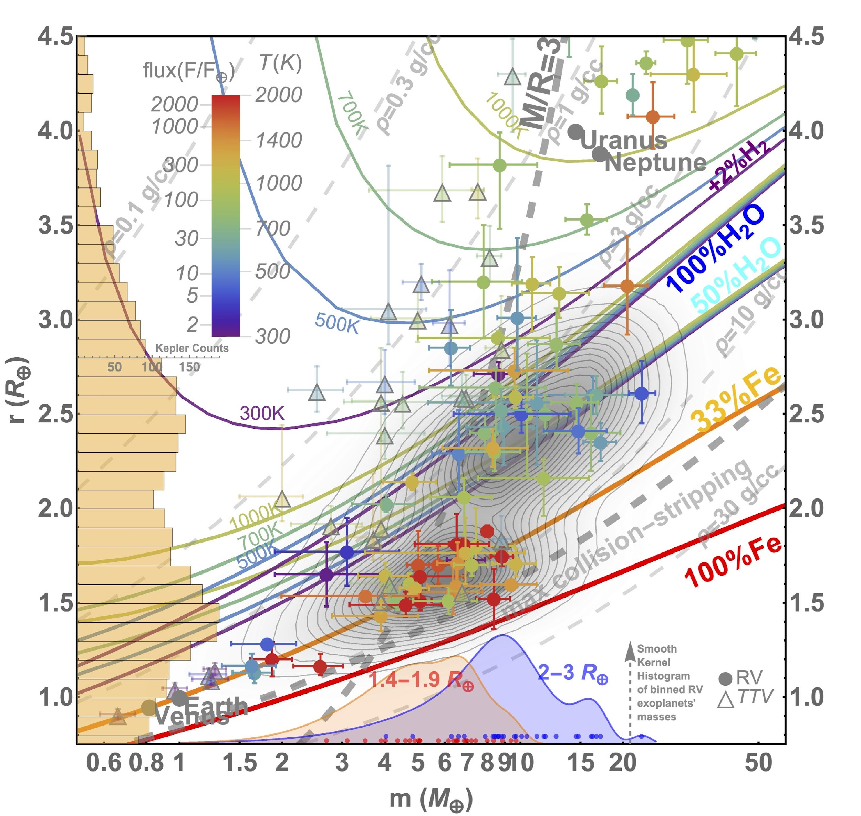
“my model matches the data”
Notes:
Just… don’t.
This plot works in a paper, because people have all the time in the world to scrutinize your figure in all it’s detail.
In a talk, this slide is going to be on the screen for 1 minute, MAX. Any longer and you’ll lose your audience.
Instead, distill your science to the one core message you want to convey. Here, it’’s “my model matches the data”

Slide 25
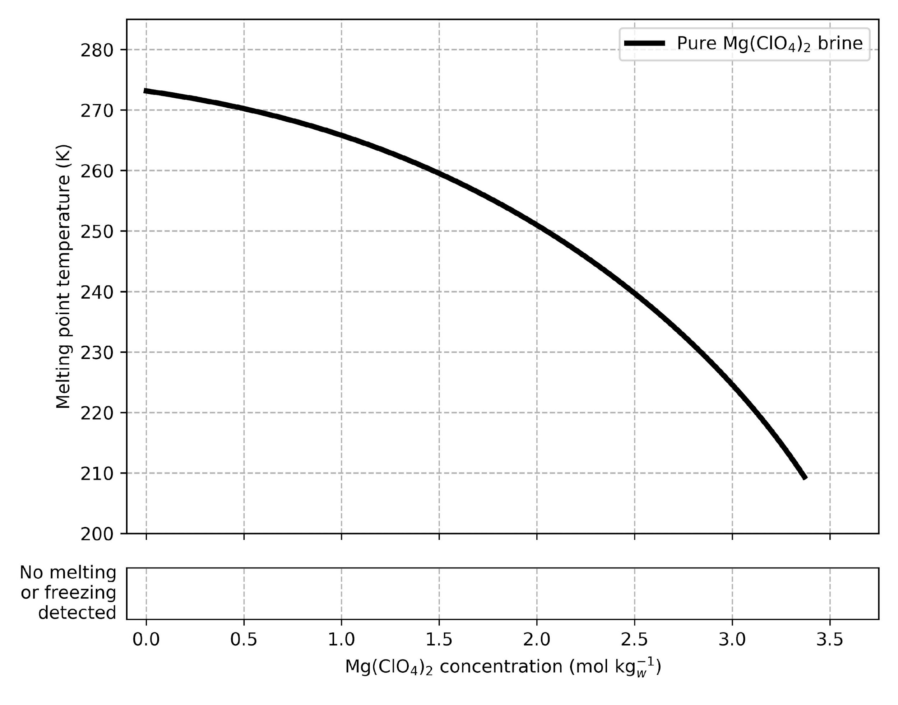
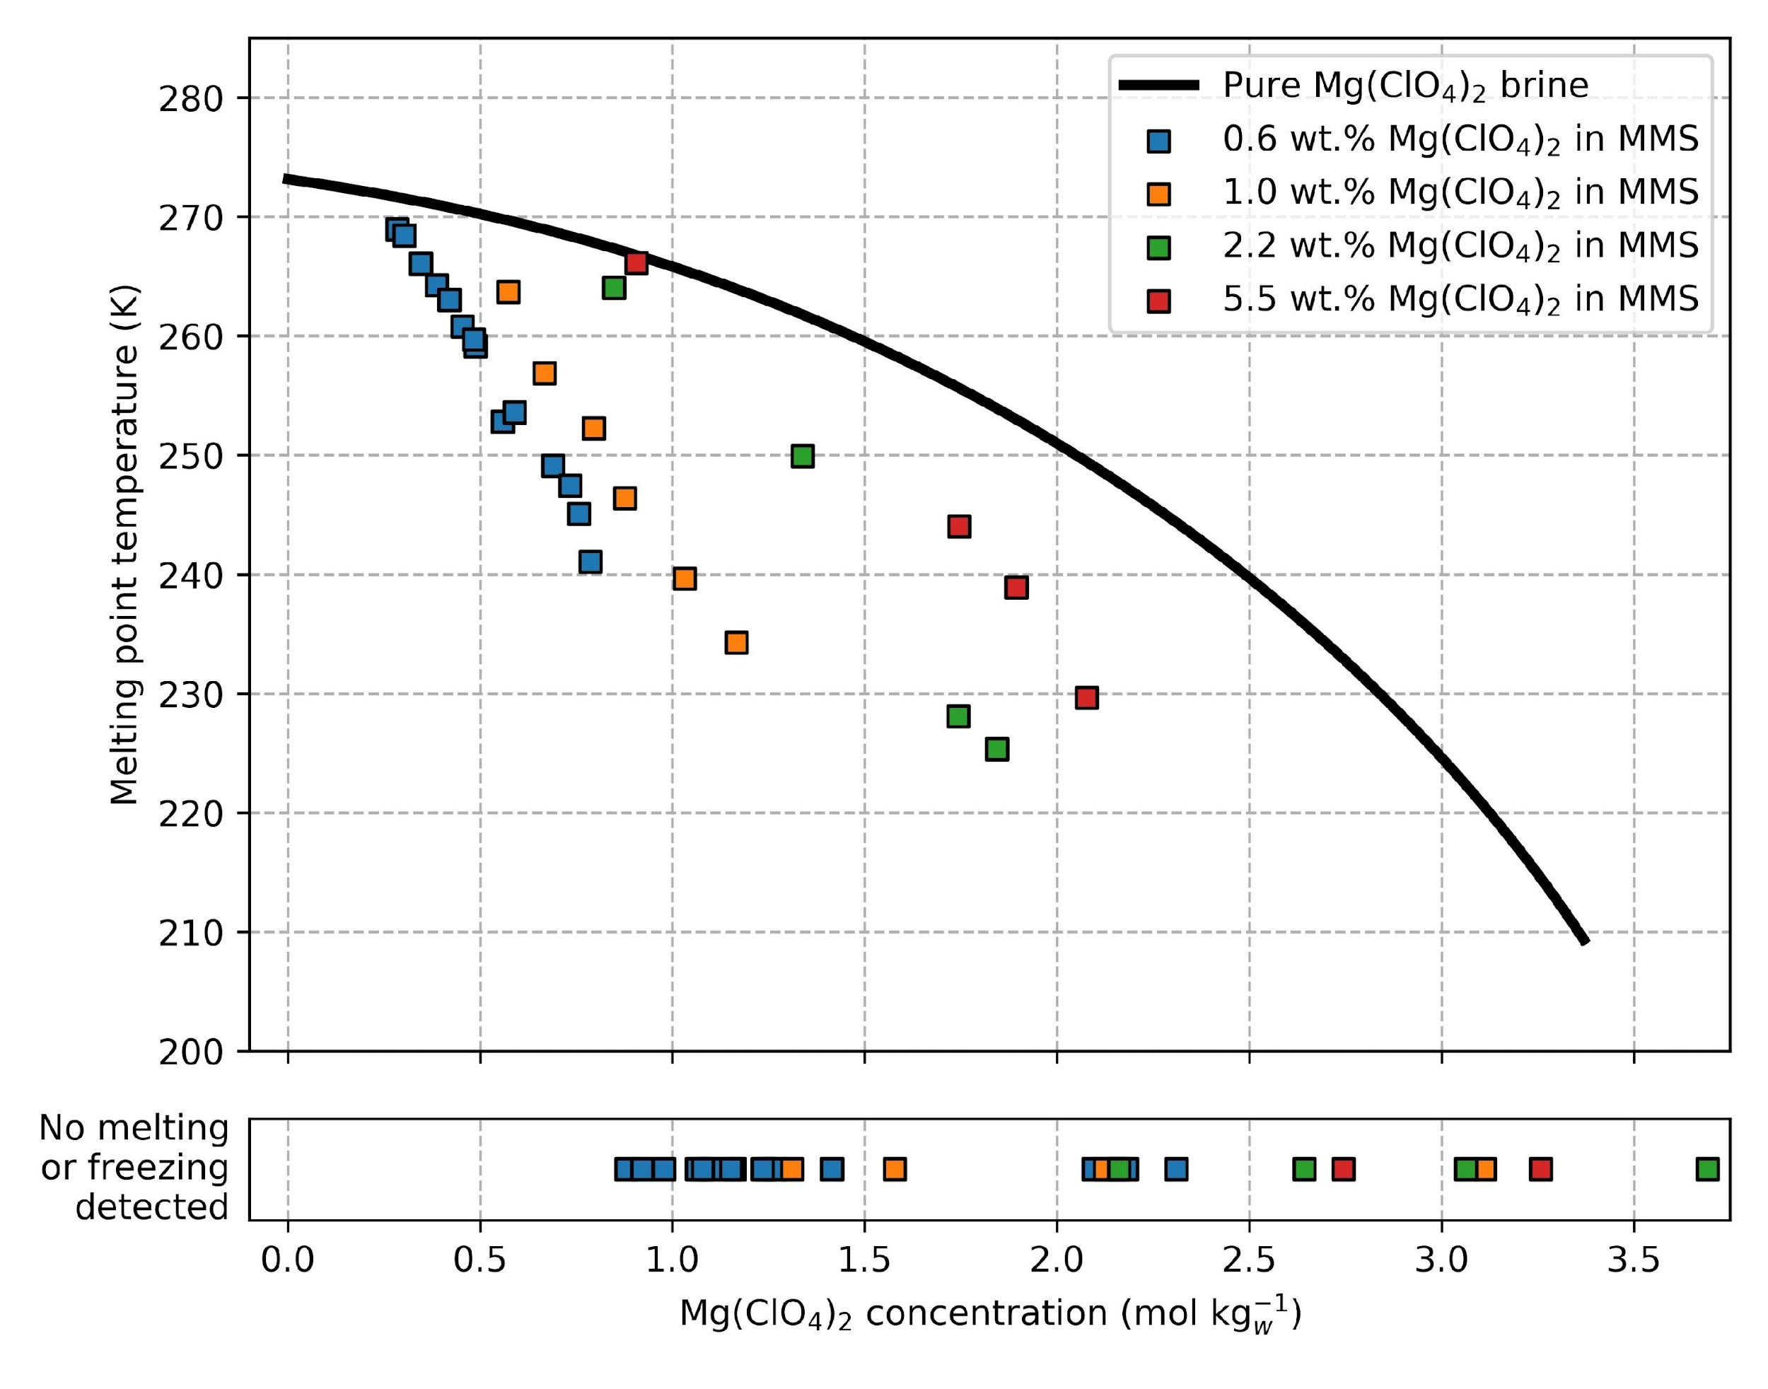
Soils Depress the Melting Point & Inhibit Freezing
Explain X & Y axes
Direct audience’s attention, walk them through
Melting Temperature (K)
In the driest samples, the briny regolith never froze!
Salt content (moles / kg_{water})
Salt content (moles / kg_{water})
Notes:
Main point as title.

Slide 26
Why do we get nervous when speaking?

Slide 27
Dealing with Nerves
Remember, it’s biological!
  You may need to physically remind your body that it is safe.
Remember your audience wants you to succeed
Practice!!
  Practice your intro the most. Nail the intro and the rest of the talk will flow.
  Public speaking is a skill, and you will get better with practice.

Slide 28
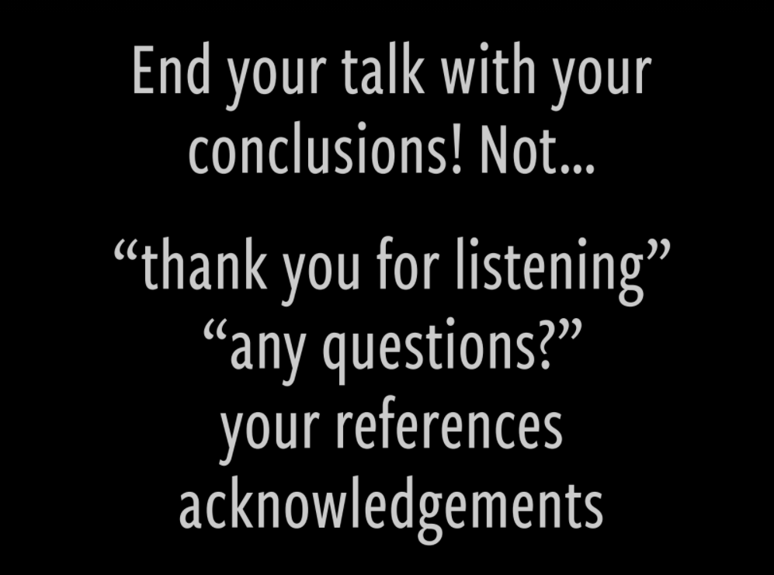

Slide 29
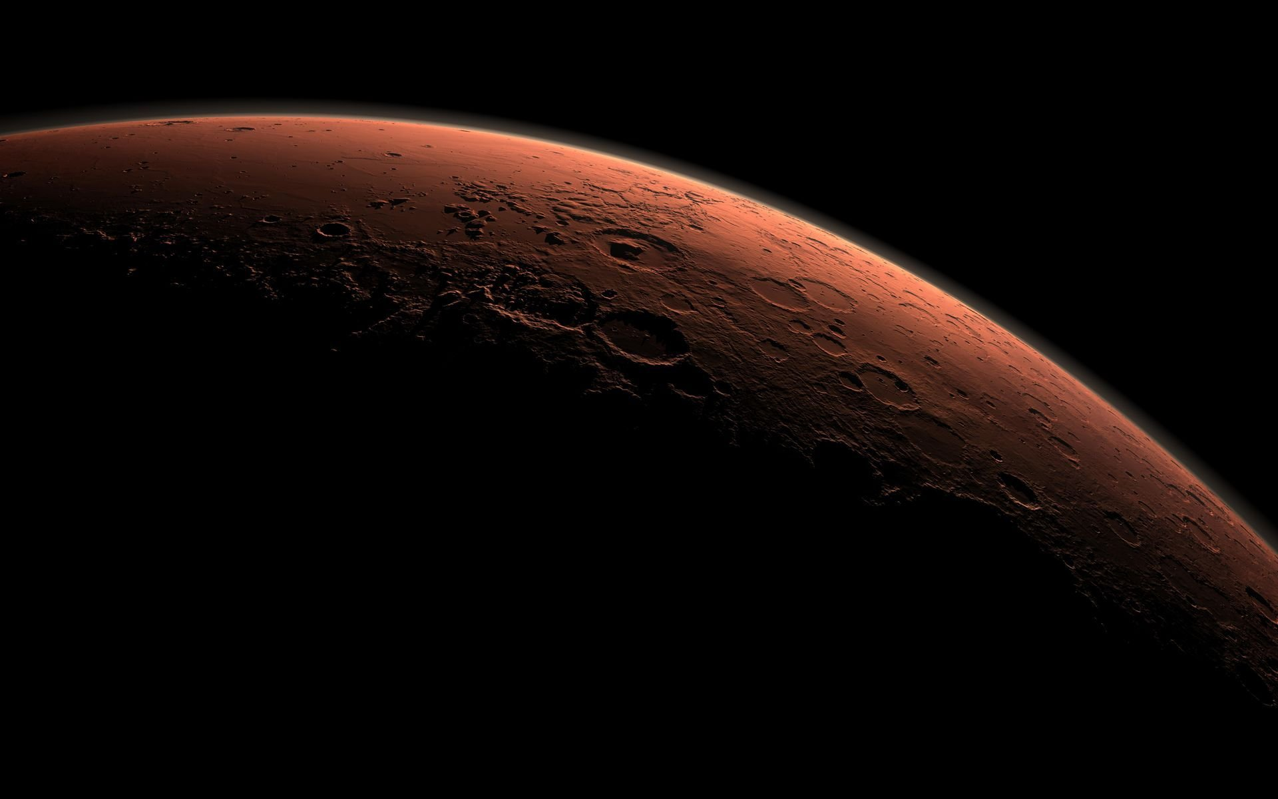
Do
Connect with your audience
Outline
Slide design:
Use large text
Have a few key words per slide
Use a lot of visuals/figure
Introduce plots & equations slowly
Presentation:
Face the audience
Practice!!
Do NOT
Use overly technical jargon
Put excessive text/bullet points
Read off the slides
Panic

